Slide 1
Navigation and Routing Additional Techniques

Slide 2


Slide 3

Module Overview
Passing parameters to a route
Activating a route with code Protecting routes with guards

Slide 4
Application Architecture
Welcome Component
index.html
App Component
Product List Component
Star Component
Product Detail Component
Product Data Service

Slide 5
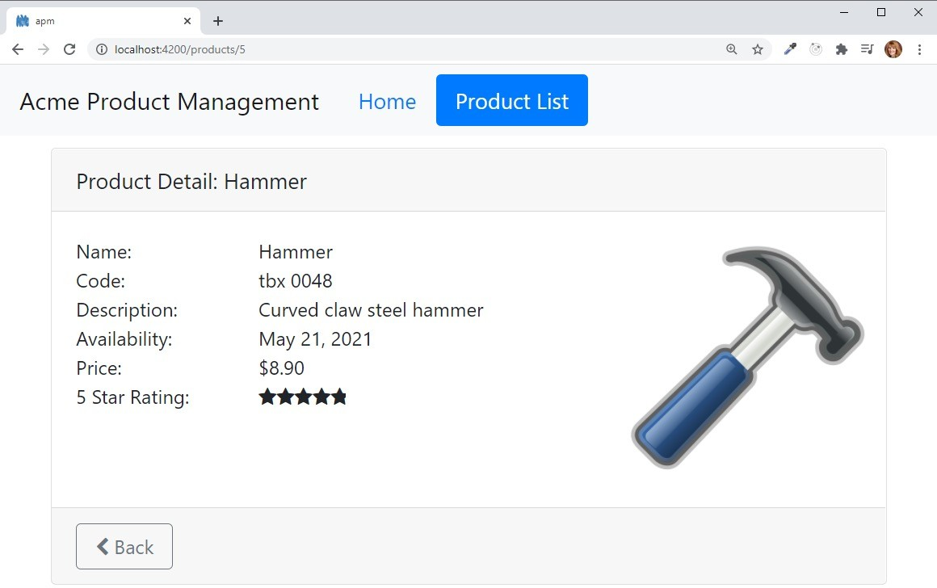
Passing Parameters to a Route

Slide 6
Passing Parameters to a Route
app.module.ts
@NgModule({ imports: [
...,
RouterModule.forRoot([
{ path: 'products', component: ProductListComponent },
{ path: 'products/:id', component: ProductDetailComponent },
{ path: 'welcome', component: WelcomeComponent },
{ path: '', redirectTo: 'welcome', pathMatch: 'full' },
{ path: '**', redirectTo: 'welcome', pathMatch: 'full' }
])
],
declarations: [...], bootstrap: [ AppComponent ]
})
export class AppModule { }

Slide 7
Passing Parameters to a Route
product-list.component.html
<td>
<a [routerLink]="['/products', product.productId]">
{{product.productName}}
</a>
</td>
app.module.ts
{ path: 'products/:id', component: ProductDetailComponent }

Slide 8
Reading Parameters from a Route

Slide 9
Reading Parameters from a Route
product-detail.component.ts
import { ActivatedRoute } from '@angular/router';
constructor(private route: ActivatedRoute) { }
app.module.ts
{ path: 'products/:id', component: ProductDetailComponent }

Slide 10



Reading Parameters from a Route
Snapshot : Read the parameter one time
this.route.snapshot.paramMap.get('id');
Observable: Read emitted parameters as they change
this.route.paramMap.subscribe(
params => console.log(params.get('id'))
);
Specified string is the route parameter name
{ path: 'products/:id',
component: ProductDetailComponent }

Slide 11
Demo
Passing parameters to a route

Slide 12
Demo
Handling null and undefined

Slide 13
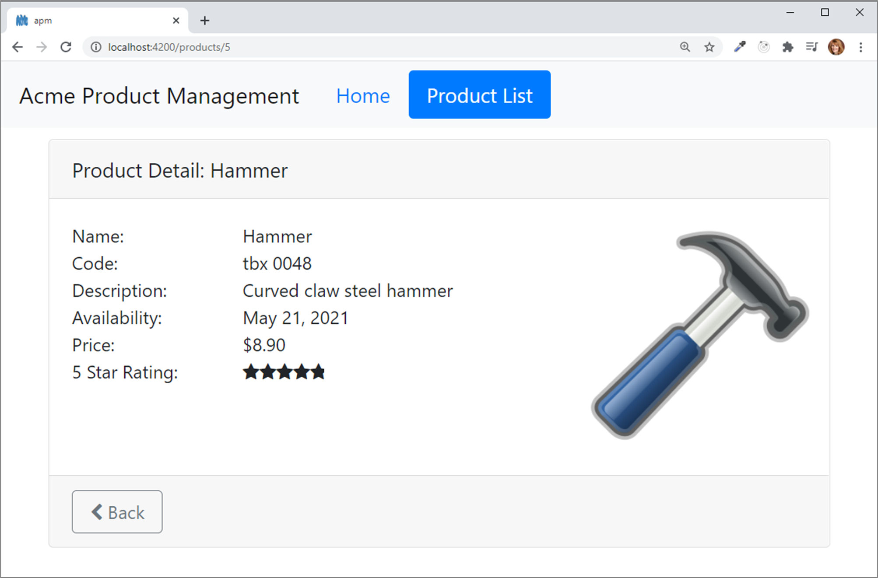
Activating a Route with Code

Slide 14
Activating a Route with Code
product-detail.component.ts
import { Router } from '@angular/router';
...
constructor(private router: Router) { }
onBack(): void { this.router.navigate(['/products']);
}

Slide 15



Protecting Routes with Guards
Limit access to a route
Restrict access to only certain users
Require confirmation before navigating away

Slide 16

Protecting Routes with Guards
CanActivate
Guard navigation to a route
CanDeactivate
Guard navigation from a route
Resolve
Pre-fetch data before activating a route
CanLoad
Prevent asynchronous routing

Slide 17
Building a Guard
product-detail.guard.ts
import { Injectable } from '@angular/core'; import { CanActivate } from '@angular/router';
@Injectable({ providedIn: 'root'
})
export class ProductDetailGuard implements CanActivate {
canActivate(): boolean {
...
}
}

Slide 18
Using a Guard
app.module.ts
@NgModule({ imports: [
...,
RouterModule.forRoot([
{ path: 'products', component: ProductListComponent },
{ path: 'products/:id',
canActivate: [ ProductDetailGuard ], component: ProductDetailComponent },
...])
],
declarations: [...], bootstrap: [ AppComponent ]
})
export class AppModule { }

Slide 19
Demo
Protecting routes with guards

Slide 20
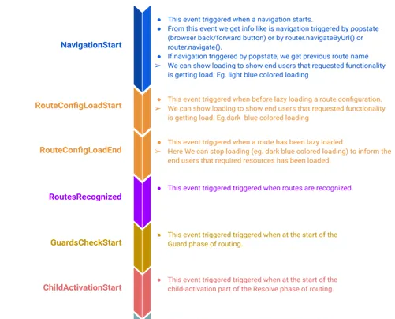
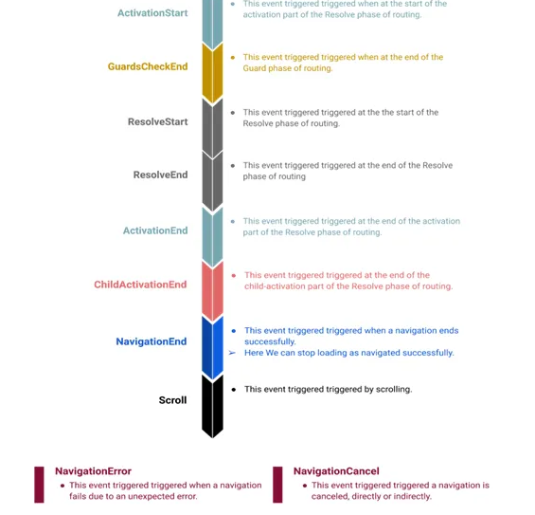
Angular Routing Events
Reference: https://angular.io/api/router/RouterEvent

Slide 21

General Checklist: Null and Undefined
Prevent null or undefined errors in a template
- Safe navigation operator (?)
{{product?.productName}}
{{product?.supplier?.companyName}}
- *ngIf directive
<div *ngIf='product'>
<div>Name:</div>
<div>{{product.productName}}</div>
<div>Description:</div>
<div>{{product.description}}</div>
</div>

Slide 22
Routing Checklist: Passing Parameters
app.module.ts
{ path: 'products/:id', component: ProductDetailComponent }
product-list.component.html
<a [routerLink]="['/products', product.productId]">
{{product.productName}}
</a>
product-detail.component.ts
import { ActivatedRoute } from '@angular/router';
constructor(private route: ActivatedRoute) { console.log(this.route.snapshot.paramMap.get('id'));
}

Slide 23
Routing Checklist: Activate a Route with Code
Use the Router service
Define it as a dependency
Create a method that calls the navigate method of the Router service
Pass in the link parameters array
import { Router } from '@angular/router';
...
constructor(private router: Router) { }
onBack(): void { this.router.navigate(['/products']);
}
Add a user interface element
- Use event binding to bind to the created method
<button (click)='onBack()'>Back</button>

Slide 24
Routing Checklist: Protecting Routes with Guards
Build a guard service
Implement the guard type (CanActivate)
Create the method (canActivate())
Register the guard service provider
Use the providedIn property
import { Injectable } from '@angular/core'; import { CanActivate } from '@angular/router';
@Injectable({ providedIn: 'root' })
export class ProductDetailGuard implements CanActivate { canActivate(): boolean { ... }
}
Add the guard to the desired route
{ path: 'products/:id', canActivate: [ ProductDetailGuard ], component: ProductDetailComponent },

Slide 25
Application Architecture
Welcome Component
index.html
App Component
Product List Component
Star Component
Product Detail Component
Product Data Service

Slide 26
AppModule
BrowserModule |  | FormsModule |  | HttpClientModule |  | RouterModule
AppComponent
Produ Comp | ctList onent
ConvertT Pi | oSpaces pe
StarComponent
ProductDetail Component
WelcomeComponent
Imports Exports Declarations Bootstrap

Slide 27
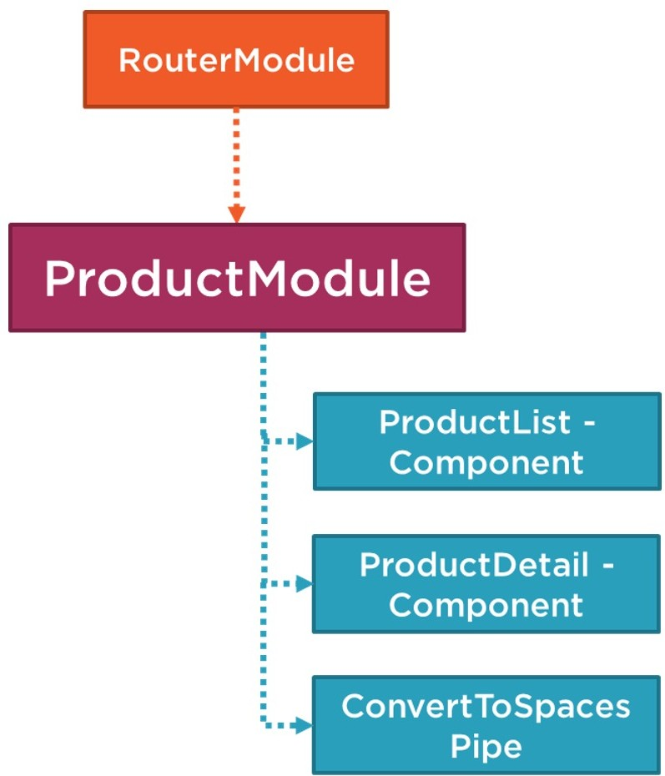
Coming up next …
Angular Modules

